Slide 1
Attendance Management System
Web : https://www.echonet.in
Employee enters the Job place.
Click Camera button to capture image and click IN button.
In time , Image and GPS location saved online.
During leaving the duty place Employee click OUT button,
leaving time with GPS saved.
App will calculate total hours of availability of employee.
Manager can check the entry and exit time with Google location.

Slide 2
Attendance Management System
Web : https://www.echonet.in
Employee enters the Job place.
Click Camera button to capture image and click IN button.
In time , Image and GPS location saved online.
During leaving the duty place Employee click OUT button,
leaving time with GPS saved.
App will calculate total hours of availability of employee.
Manager can check the entry and exit time with Google location.

Slide 3
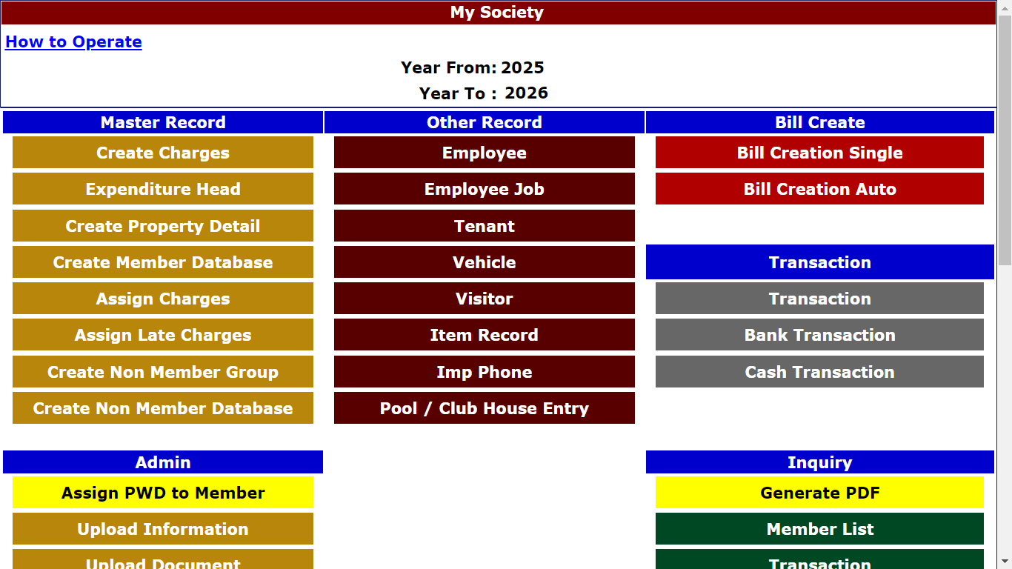
Attendance Management System
Add Employee

Slide 4
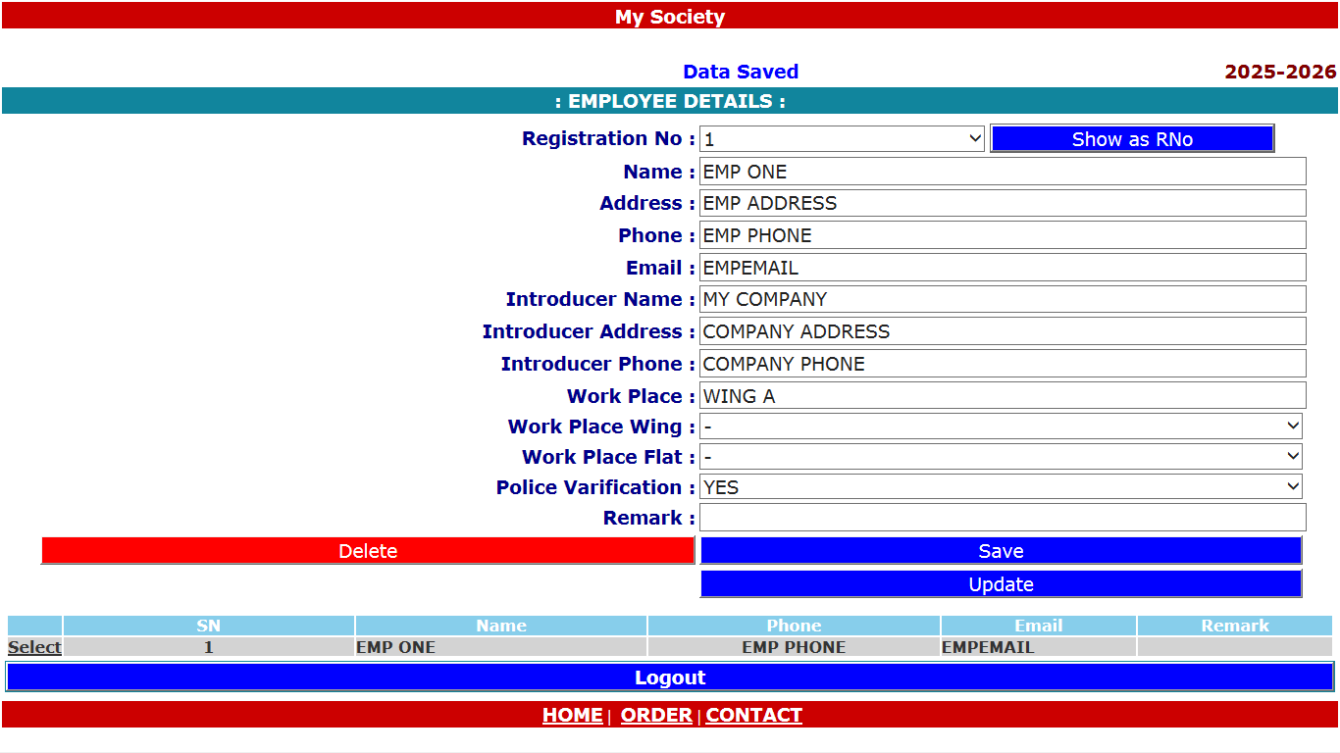
Employee Database

Slide 5
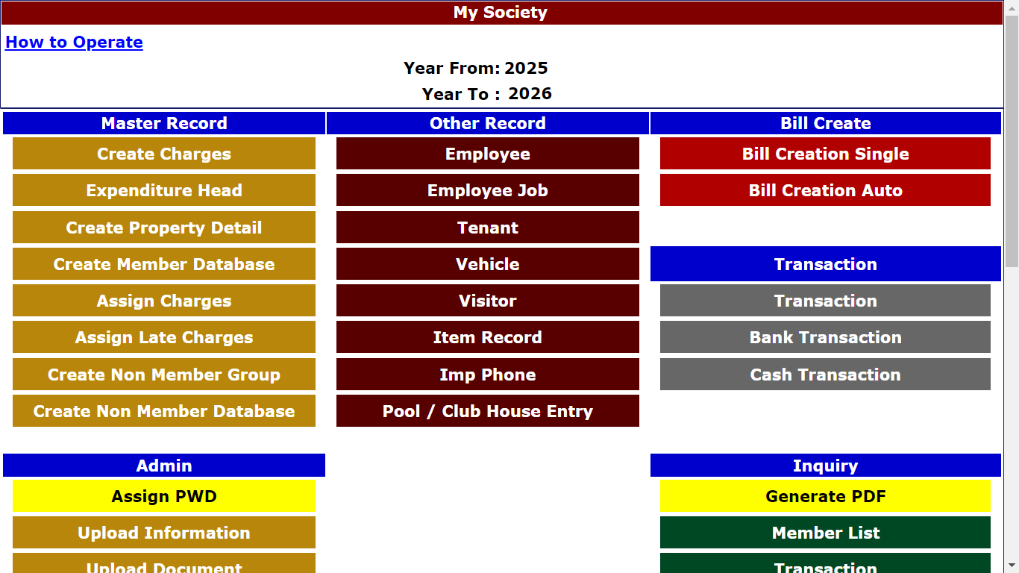
Assign Password to Employee

Slide 6
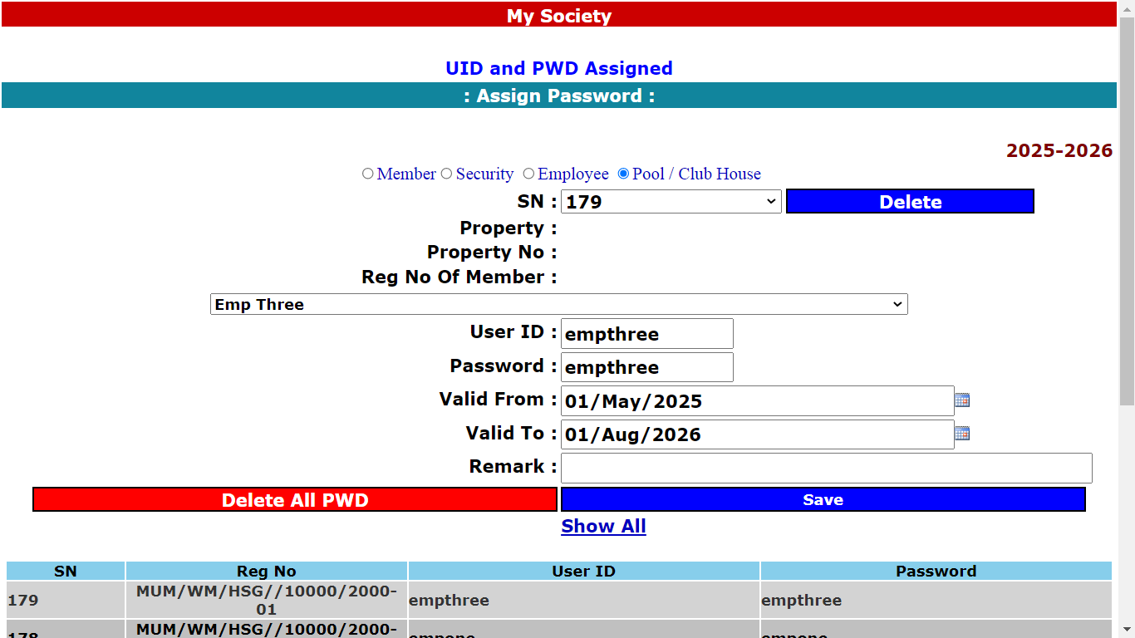
Assign Password to Employee
Select Member , Security , Employee or Pool / Club house.
Write User Id and Password , Click Save.
With assigned Password, Member and all employee can use concerned page on Android App.

Slide 7
Attendance Management System
Employee Job Entry
Employee Job entry can be done using Android App or website

Slide 8
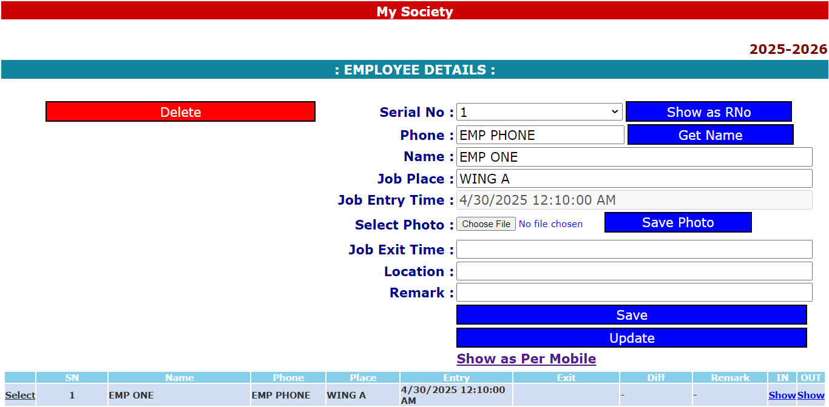
Employee Job Entry
Employee Job entry can be done using Android App or website.
GPS location will be entered using Android mobile and job exit time also taken during Exit entry.
So it is good to enter attendance using Android mobile.

Slide 9
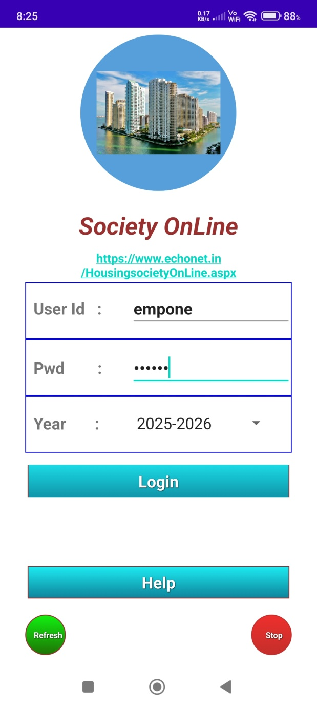
Login By Employee (Android App)

Slide 10
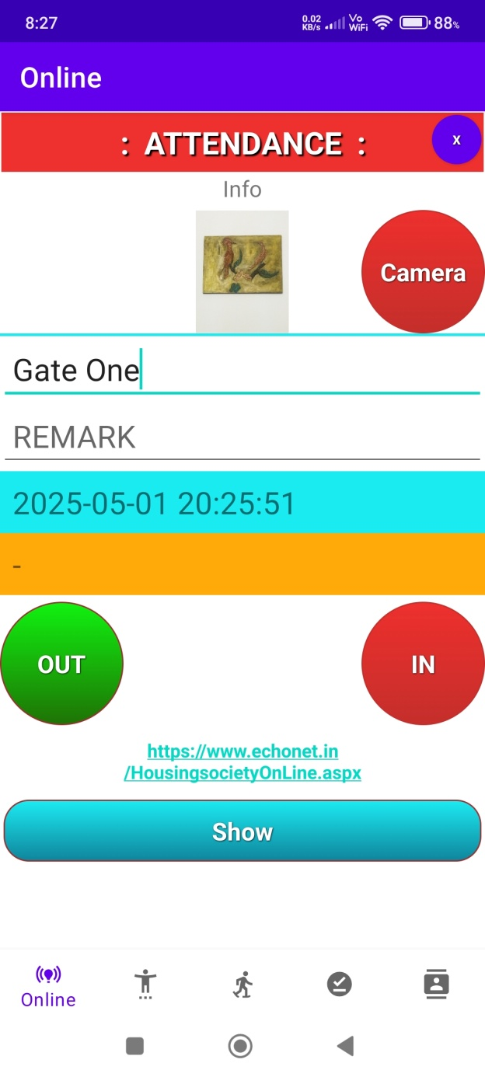
Attendance Entry
Employee enters the Job place ,
click Camera button to
capture image and click
IN button.
In time , Image and
GPS location saved online.
During leaving the duty place ,
Employee click OUT button and
leaving time with GPS saved.
App will calculate total hours
of availability of employee.
Manager can check the entry and exit time with Google location.

Slide 11
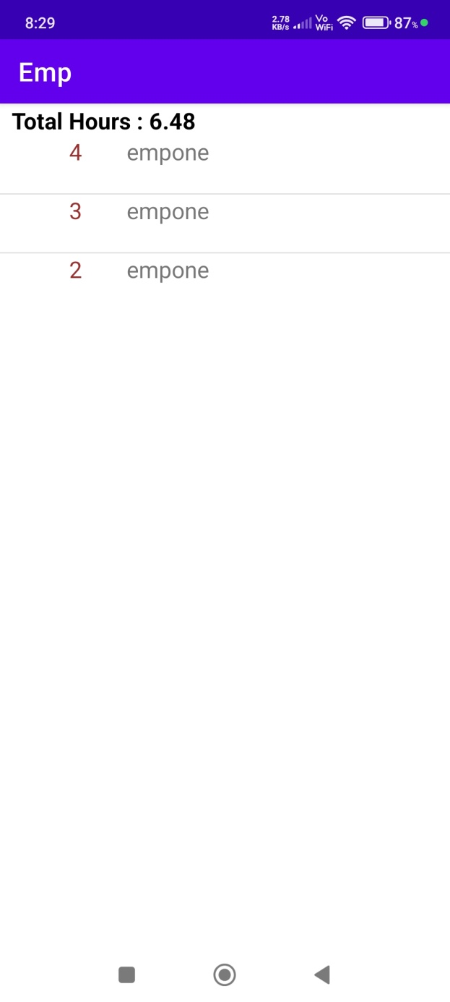
Attendance Entry
App will calculate total hours
of availability of employee.

Slide 12
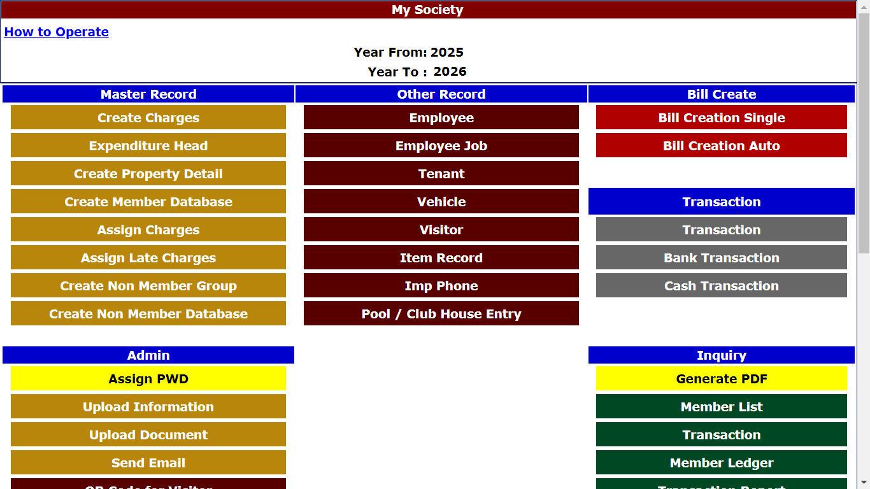
Check Employee attendance (On Website)By Manager
Check Employee attendance

Slide 13
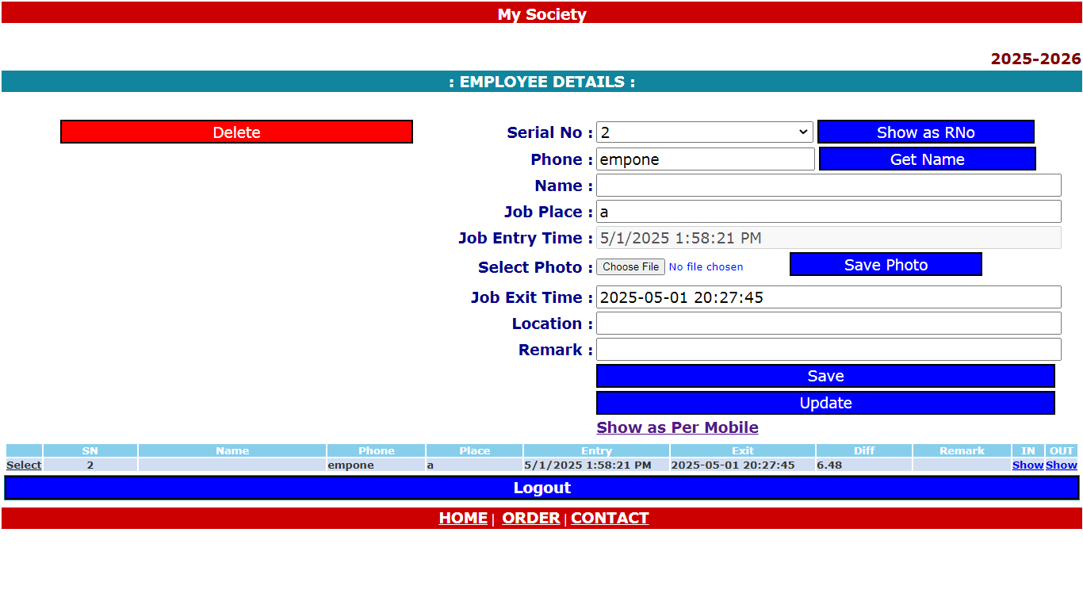
Check Employee attendance (On Website)By Manager
IN location of Employee
OUT location of Employee

Slide 14
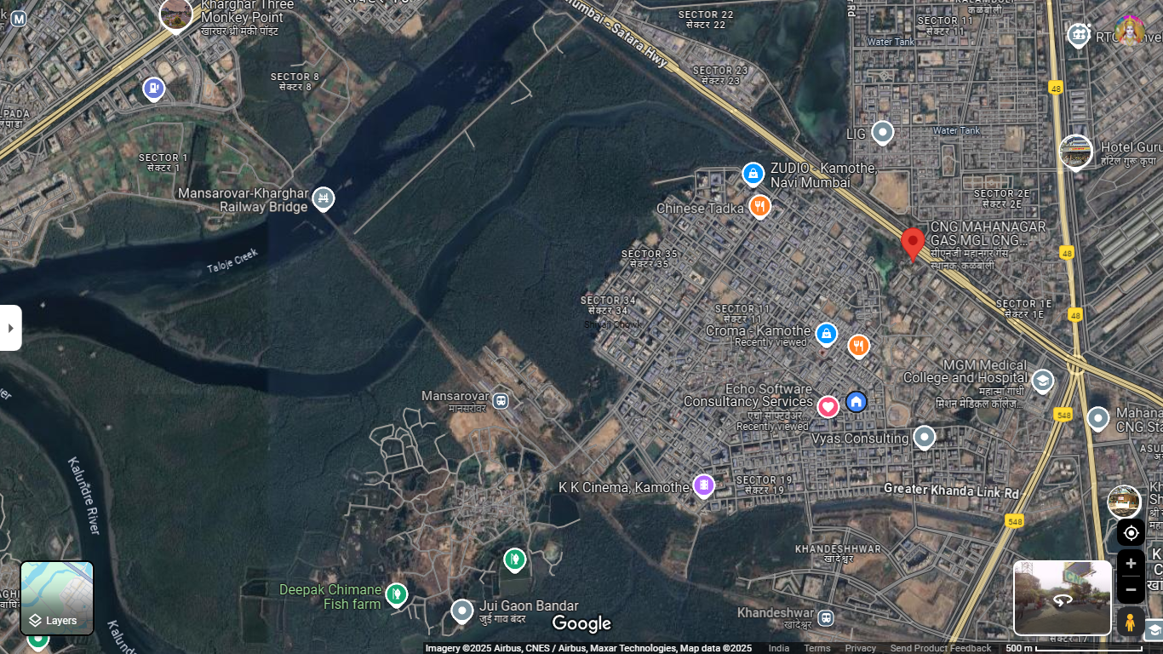
Check Employee attendance (On Website)

Slide 15

Employee Management System
: Design & Developed By :
Ram Prakash
Echo Software Consultancy Services
Mobile : +91 9821885190
Email : echonetin@yahoo.in
https://www.echonet.in/HousingsocietyOnLine.aspx

